Slide 1
Structure-based discovery of Solute Carrier (SLC) transporters’ ligands
Presented by Avner Schlessinger (Sali, Stroud, Giacomini)
CSMP Annual Meeting, UCSF
March 14th 2011

Slide 2
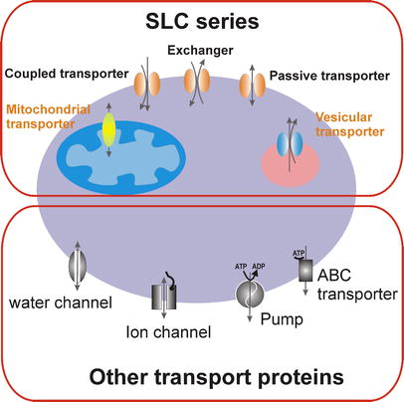
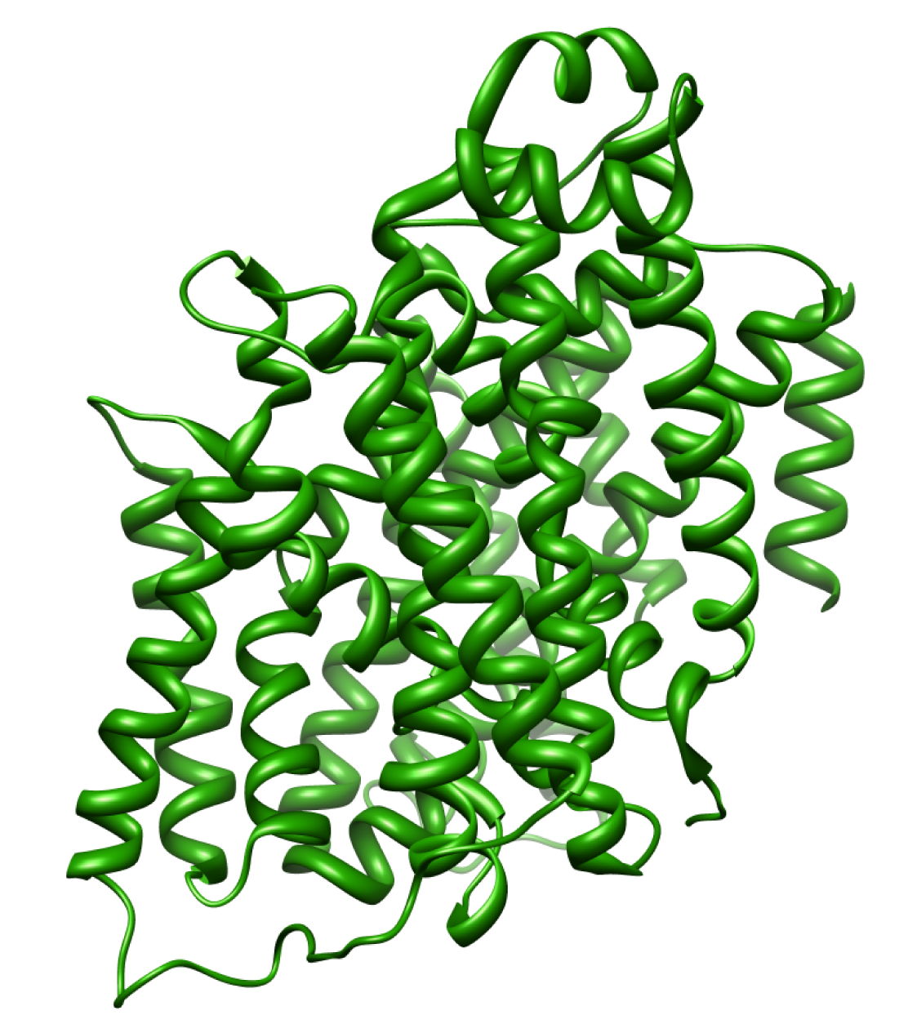
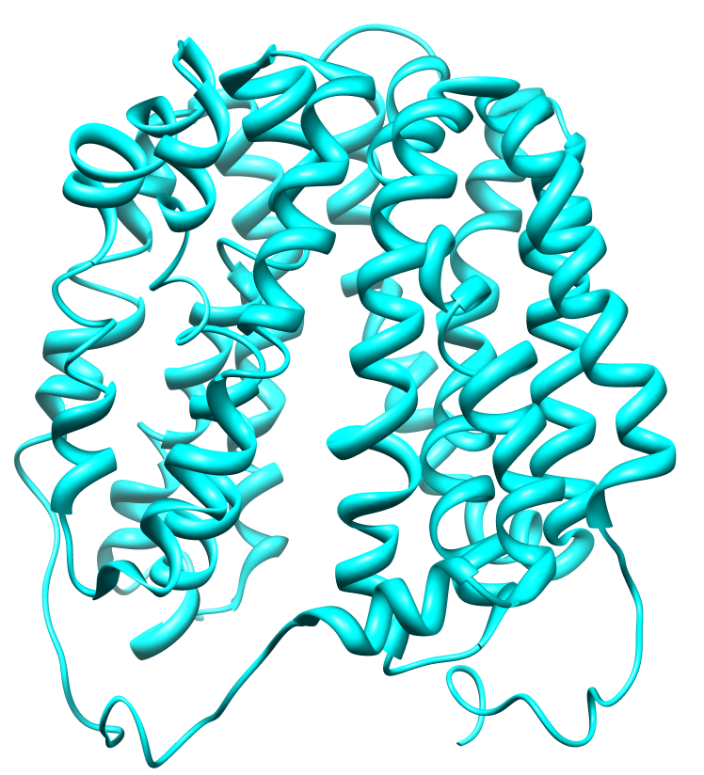
The Solute Carrier (SLC) superfamily
Includes ~400 proteins from 51 families
Predicted to have 10-14 membrane helices
Members within SLC families share ≥20% identity
There is only one structure of human SLC (RhCG, SLC42A3)
Structures of bacterial homologs have different folds (e.g., Major Facilitator Superfamily (MFS) and LeuT-like folds).
vSGLT – LeuT-like
LacY – MFS
Bruford et al. Pflugers Arch. 2004 Feb;447(5):465-8.
Faham et al. Science, 321, 810-814
Mirza et al. EMBO J, 25, 1177-1183
Notes:
Active transporters create ion/gradient across membranes using diverse energy coupling mechanisms.
Co-transport uses the downhill movement of one solute species from high to low concentration to move another molecule uphill from low concentration to high concentration (against its electrochemical gradient).
Primary active are the ABC and the pumps that
Counter-transportIn counter-transport two species of ion or other solutes are pumped in opposite directions across a membrane. One of these species is allowed to flow from high to low concentration which yields the entropic energy to drive the transport of the other solute from a low concentration region to a high one. An example is the sodium-calcium exchanger or antiporter, which allows three sodium ions into the cell to transport one calcium out.Many cells also possess a calcium ATPase, which can operate at lower intracellular concentrations of calcium and sets the normal or resting concentration of this important second messenger. But the ATPase exports calcium ions more slowly: only 30 per second versus 2000 per second by the exchanger. The exchanger comes into service when the calcium concentration rises steeply or "spikes" and enables rapid recovery. This shows that a single type of ion can be transported by several enzymes, which need not be active all the time (constitutively), but may exist to meet specific, intermittent needs.[edit]Co-transportCo-transport uses the downhill movement of one solute species from high to low concentration to move another molecule uphill from low concentration to high concentration (against its electrochemical gradient).An example is the glucose symporter SGLT1, which co-transports one glucose (or galactose) molecule into the cell for every two sodium ions it imports into the cell. This symporter is located in the small intestines, trachea, heart, brain, testis, and prostate. It is also located in the S3 segment of the proximal tubule in each nephron in the kidneys [2]. Its mechanism is exploited in glucose rehydration therapy and defects in SGLT1 prevent effective reabsorption of glucose, causing familial renal glucosuria[3].[edit]
on channels are pore-forming proteins that help establish and control the small voltage gradient across the plasma membrane of all living cells (see cell potential) by allowing the flow of ions down their electrochemical gradient.[1] They are present in the membranes that surround all biological cells.
Passive transport means moving biochemicals and atomic or molecular substances across the cell membrane. Unlike active transport, this process does not involve chemical energy. The four main kinds of passive transport are diffusion, facilitated diffusion, filtration and osmosis.

Slide 3
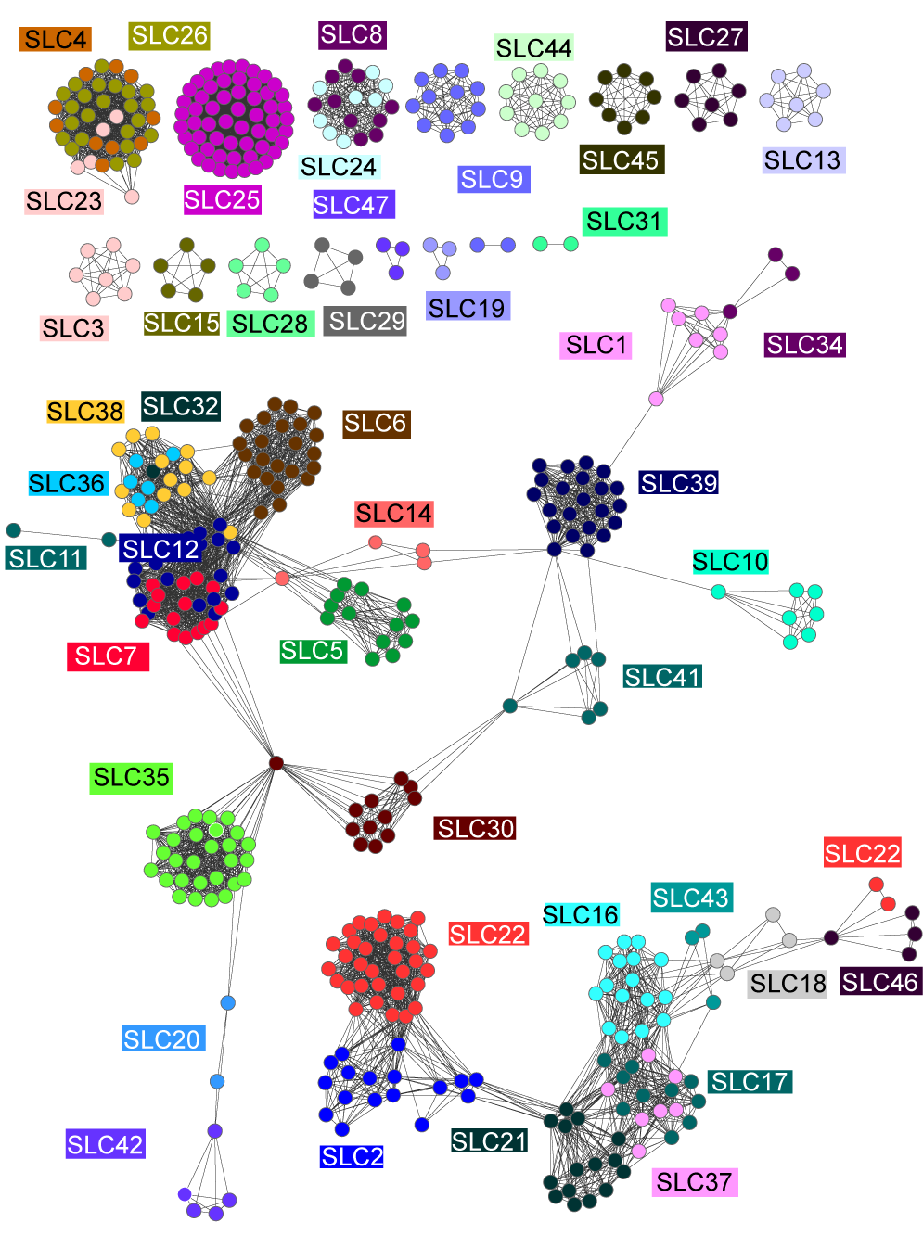
Functional characterization guided by sequence comparison
LeuT-like
MFS
Schlessinger et al. Protein Sci. 2010 Mar;19(3):412-28
Chen et al. J Pharmacol Exp Ther. 2010 Oct;335(1):42-50
Chen et al. Pharmacogenet Genomics. 2010 Nov;20(11):687-99
Xuan et al. submitted.
Notes:
Change to better resolution
Add structures of SLC25,SLC6, SLC5 and NSS, SLC1
Superposition from gouaux paper

Slide 4

Goal: structure-based discovery of SLC ligands
Find unknown biological functions
Find leads with novel scaffolds for drug development
Describe substrate specificity within SLC families
Aid in structure determination by the CSMP

Slide 5
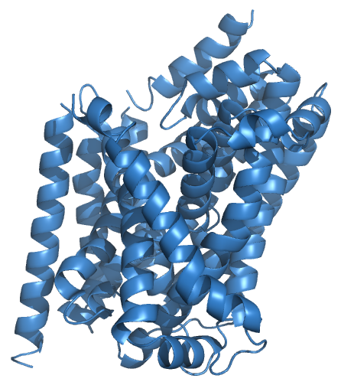
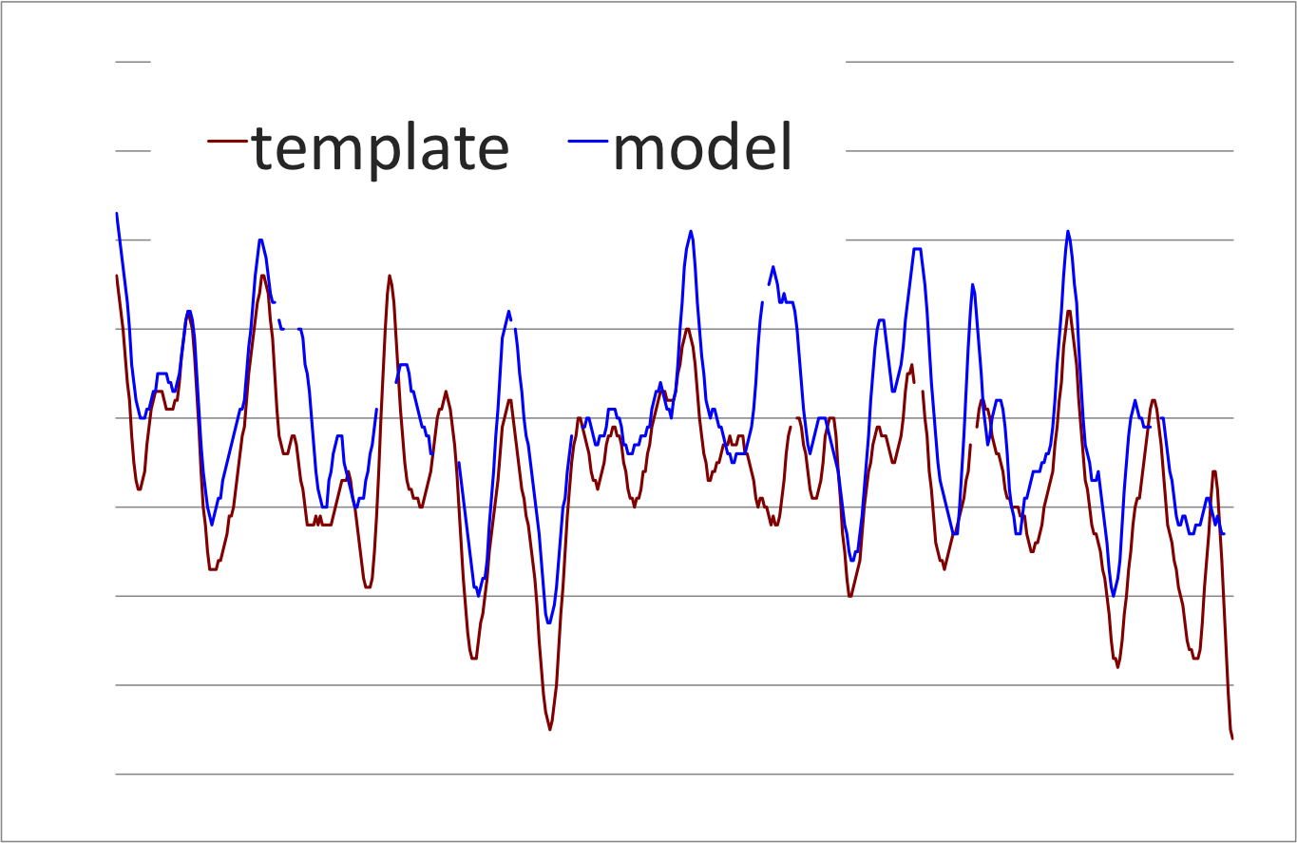
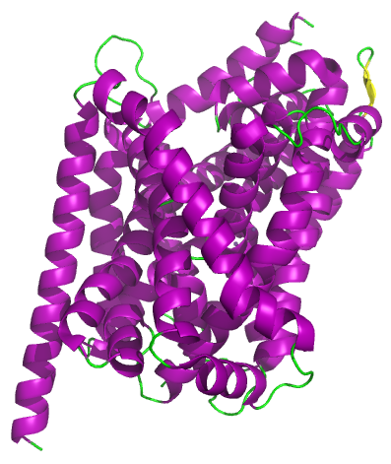

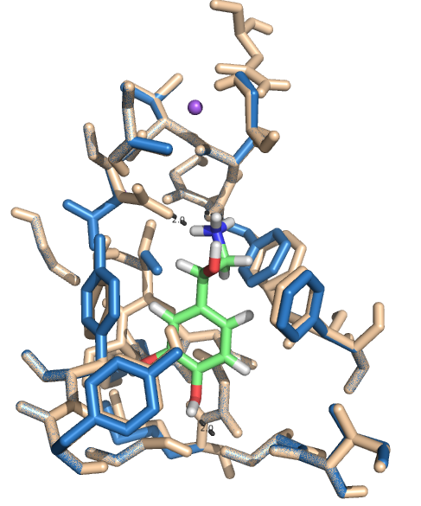
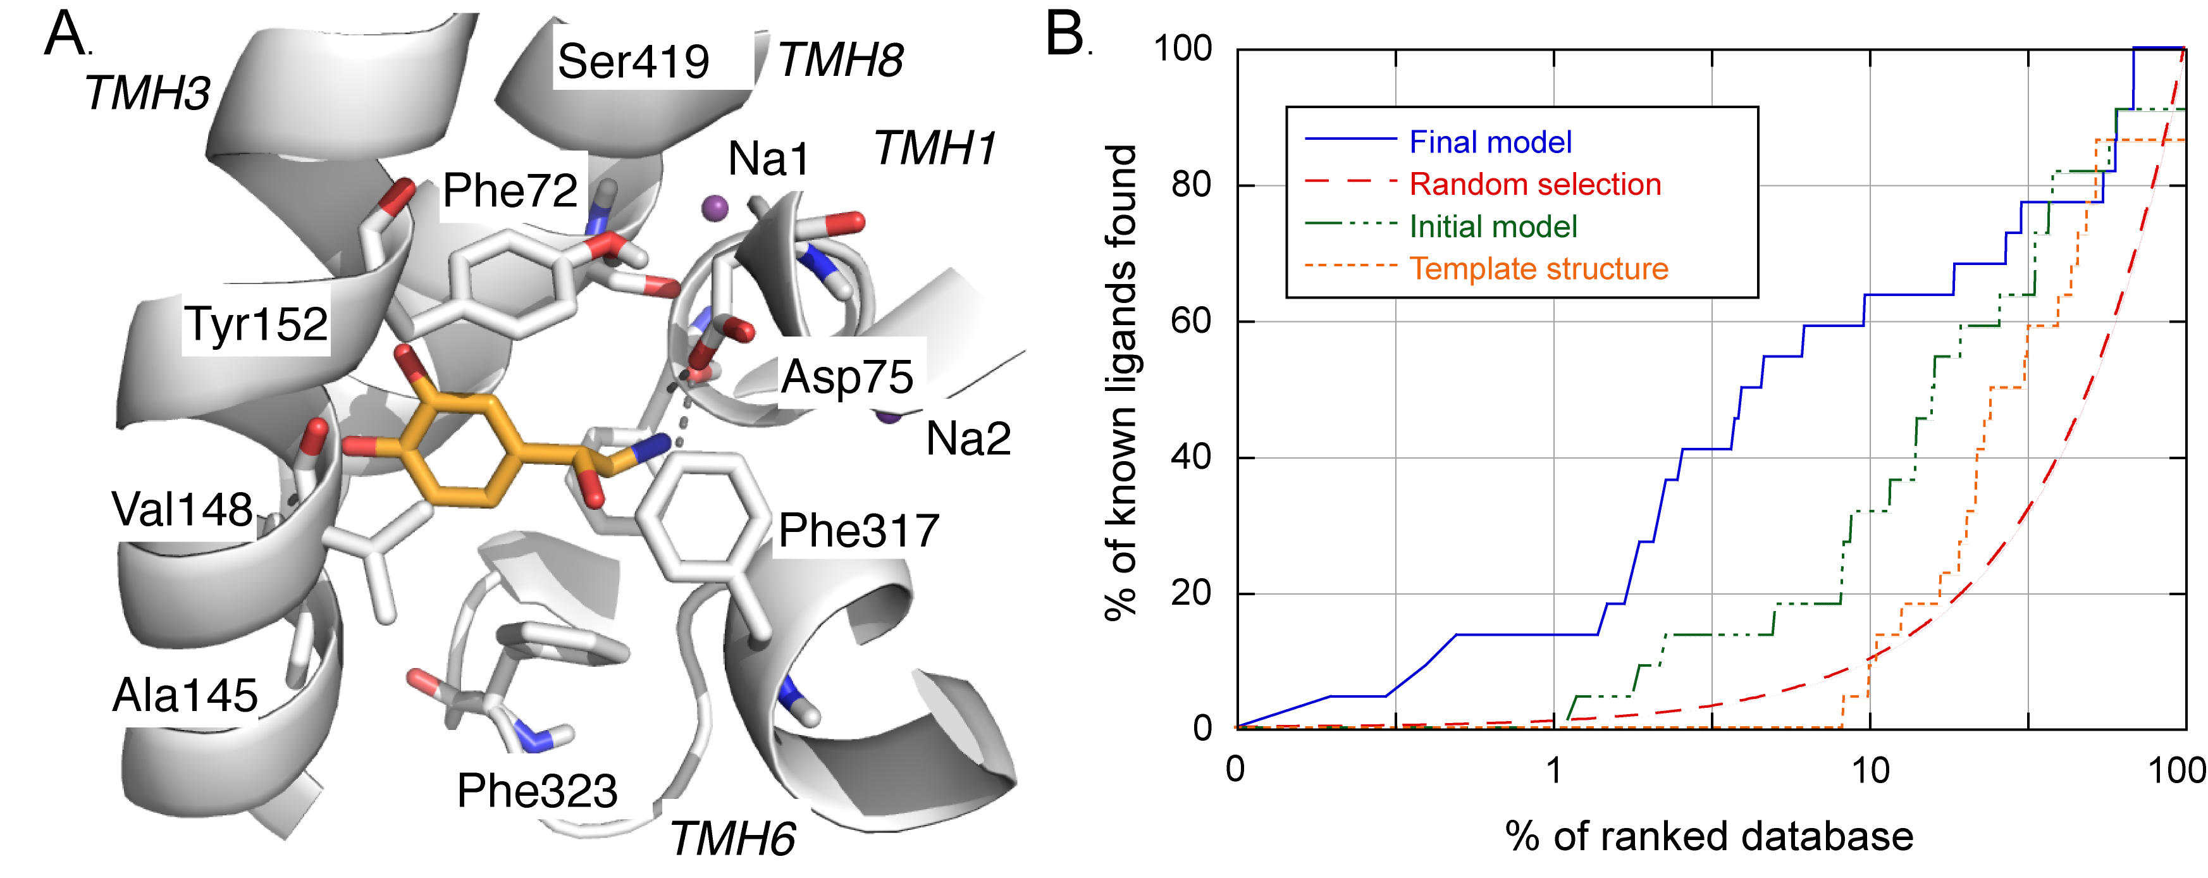


Approach: comparative modeling, docking, and virtual screening
Search for template structure (PDB, OPM)
B. Align target and template (SALIGN, PROMALS3D)
C. Construct and assess model (MODELLER, Z-DOPE)
Target protein sequence: GGMEAVITGLADDFQAA
GGMEAVITGLADDFQAA
AIM--QPMIAFLEDELKL-
F. Virtual screening
E. Computationally Validate binding site (DOCK, DUD)
D. Refine side chains (SCWRL4)

Slide 6
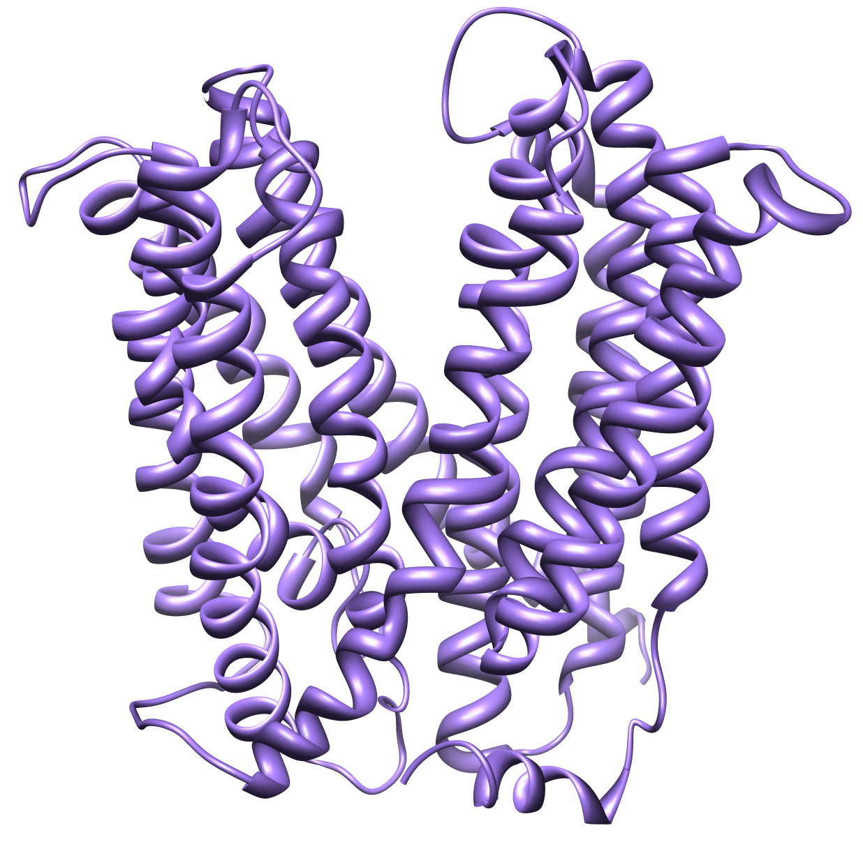
Targets for ligand discovery
Multi antimicrobial extrusion (MATE) family
LeuT-like
MATE1 (SLC47A1)
NET (SLC6A2)
GAT2 (SLC6A13)
LAT1 (SLC7A5)
MFS
Schlessinger et al. Protein Sci. 2010 Mar;19(3):412-28
Notes:
Change to better resolution
Add structures of SLC25,SLC6, SLC5 and NSS, SLC1
Superposition from gouaux paper

Slide 7
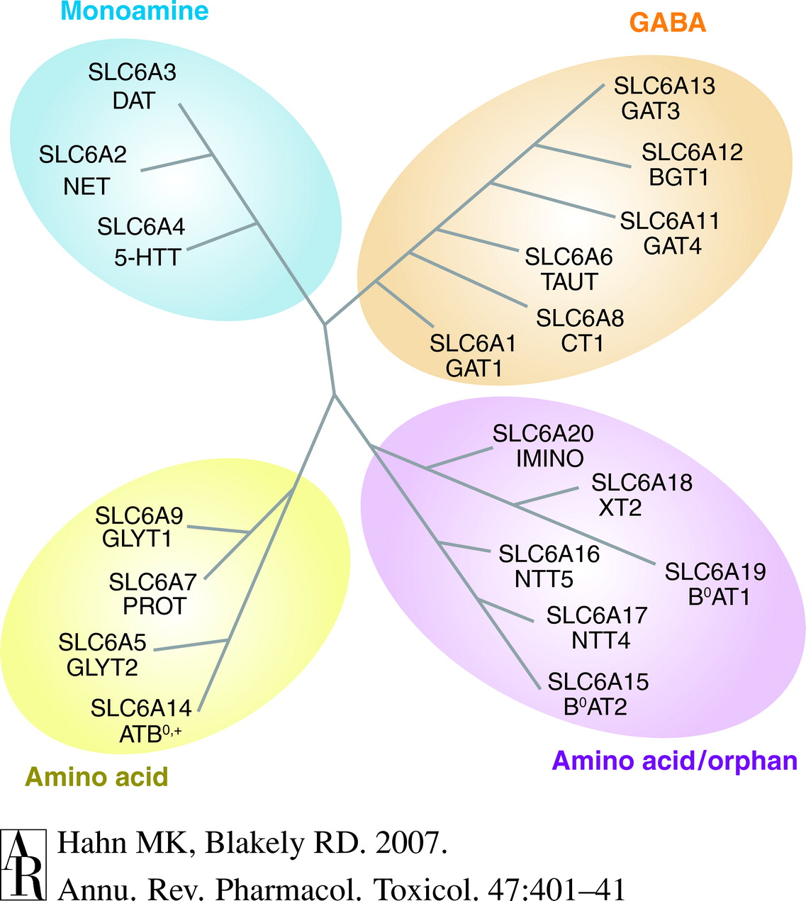
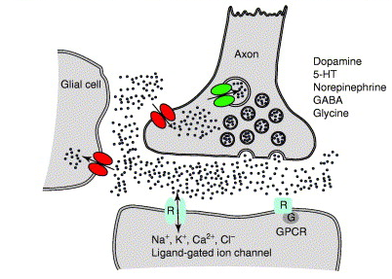
The norepinephrine transporter (NET, SLC6A2)
Biological Function:
  Na⁺- and Cl⁻- dependent neurotransmitter transporter
  Mutations are associated with attention deficit hyperactivity disorder (ADHD), panic disorder, and severe orthostatic hypotension
Pharmacology:
  Antidepressants, psychostimulants, ADHD, neuropathic pain, weight loss, nasal decongestion, hypotension
Schousboe et al. Trends Pharmacol Sci. 2006 Jul;27(7):375-83.
Notes:
The sodium- and chloride- dependent neurotransmitter transporters

Slide 8
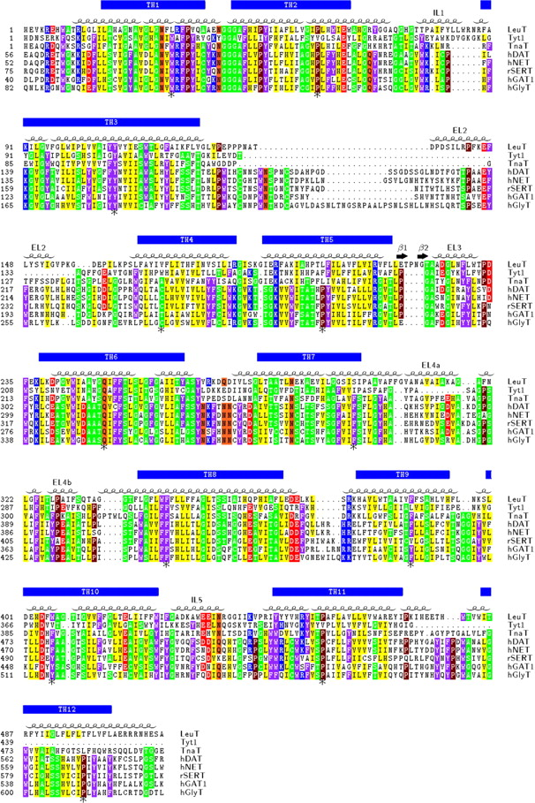
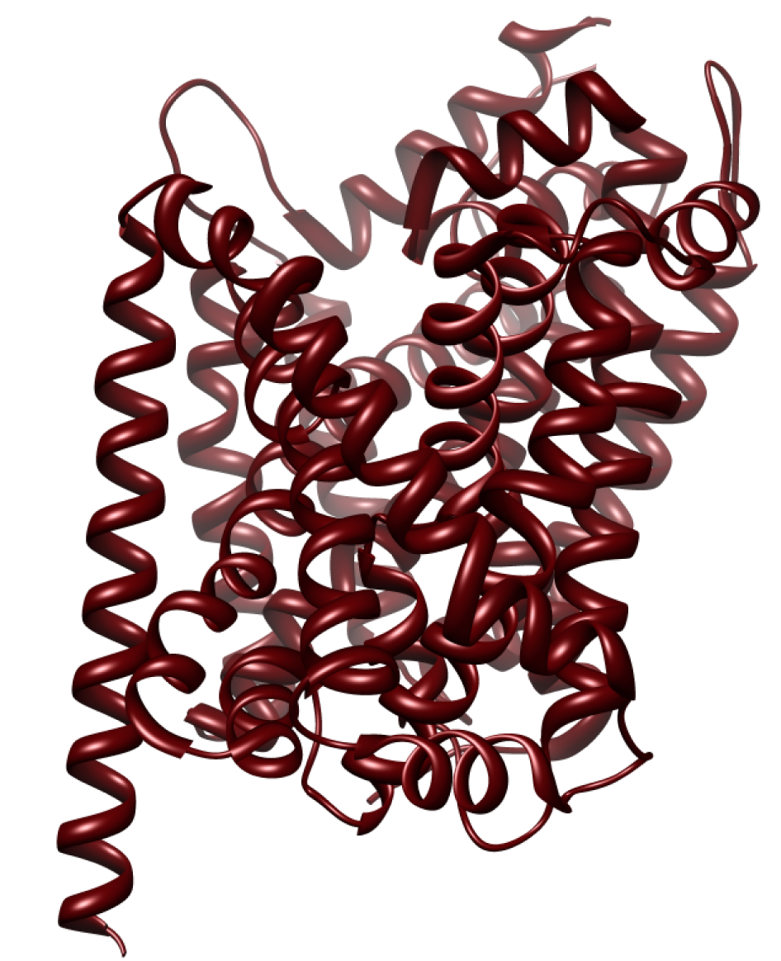
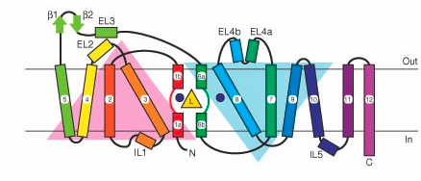
NET model based on the leucine transporter LeuT
Template
Alignment
High resolution (1.65 Å)
12 transmembrane helices
With / without substrates / inhibitors
Yamashita et al. Nature. 2007 Aug 23;448(7156):952-6.
Beuming T, Shi L, Javitch JA, Weinstein H. Mol Pharmacol. 2006 Nov;70(5):1630-42.
Abramson & Wright. Curr Opin Struct Biol. 2009 Aug;19(4):425-32. 22.
Notes:
Topology prediction (TOPPRED2, HMMTOP, ORIENTM, TMHMM, MEMSAT)
Prediction of interior and lipid-exposed faces of TM domains (knowledge-based)
Secondary structure prediction of the extracellular loops (PROFphd, PSIPRED)
Modeling and refinement (Modeller)
Validation/refinement with experimental data

Slide 9

The NET model
Was constructed using MODELLER (initial model), Scwrl4 (sidechain refinement), and DOCK (ligand docking)
Has 27% sequence identity to LeuT, covering 77% of NET
Contains the whole transmembrane domain including the primary binding site
Sali A, Blundell TL. J Mol Biol. 1993 Dec 5;234(3):779-815.
Krivov GG, Shapovalov MV, Dunbrack RL Jr. Proteins. 2009 Dec;77(4):778-95
Shoichet BK et al. 1993 Mar 5;259(5100):1445-50.

Slide 10
Final model can discriminate between ligands and non-ligands
Computationally screened 6,436 drugs from the Kyoto Encyclopedia of Genes (KEGG DRUG) database against the NET model

Slide 11
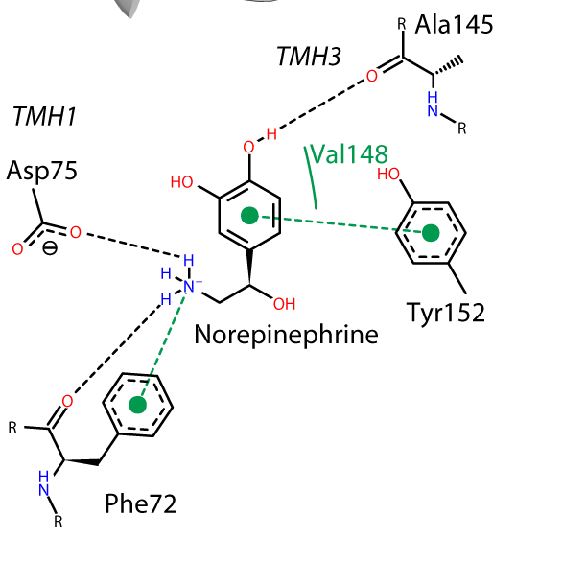
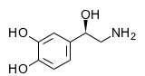



Visually analyzing the top 200 hits
Norepinephrine
Parnate
Tuaminoheptane
Phenformin
Notes:
High risk – chemically different form known substrate and/or bind in different mode
Low risk – chemically similar to known ligands. Also have related functions

Slide 12
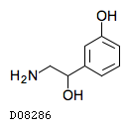

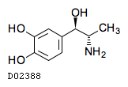
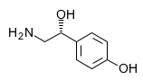
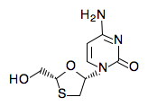


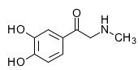
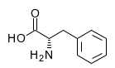
Tested drugs
High-confidence
Lower-confidence
Drug | Function | Structure
Zondel | Cardiac stimulant
Corbadrine | Vasoconstrictor; hypotensive; topical nasal decongestant
Octopamine (Epirenor) | Cardiac stimulant; hypotensive
Parnate | Antidepressant
Stryphnasal | Hemostatic; vasoconstrictor
Drug | Function | Structure
Metformin | Antidiabetic
Tuamine | Nasal decongestant; stimulant
Lamivudine | Antiviral (HIV and HBV)
Mercaptopurine | Antineoplastic; immunosuppressive
Phenformin | Antidiabetic
L-phenylalanine | Antidepressant

Slide 13
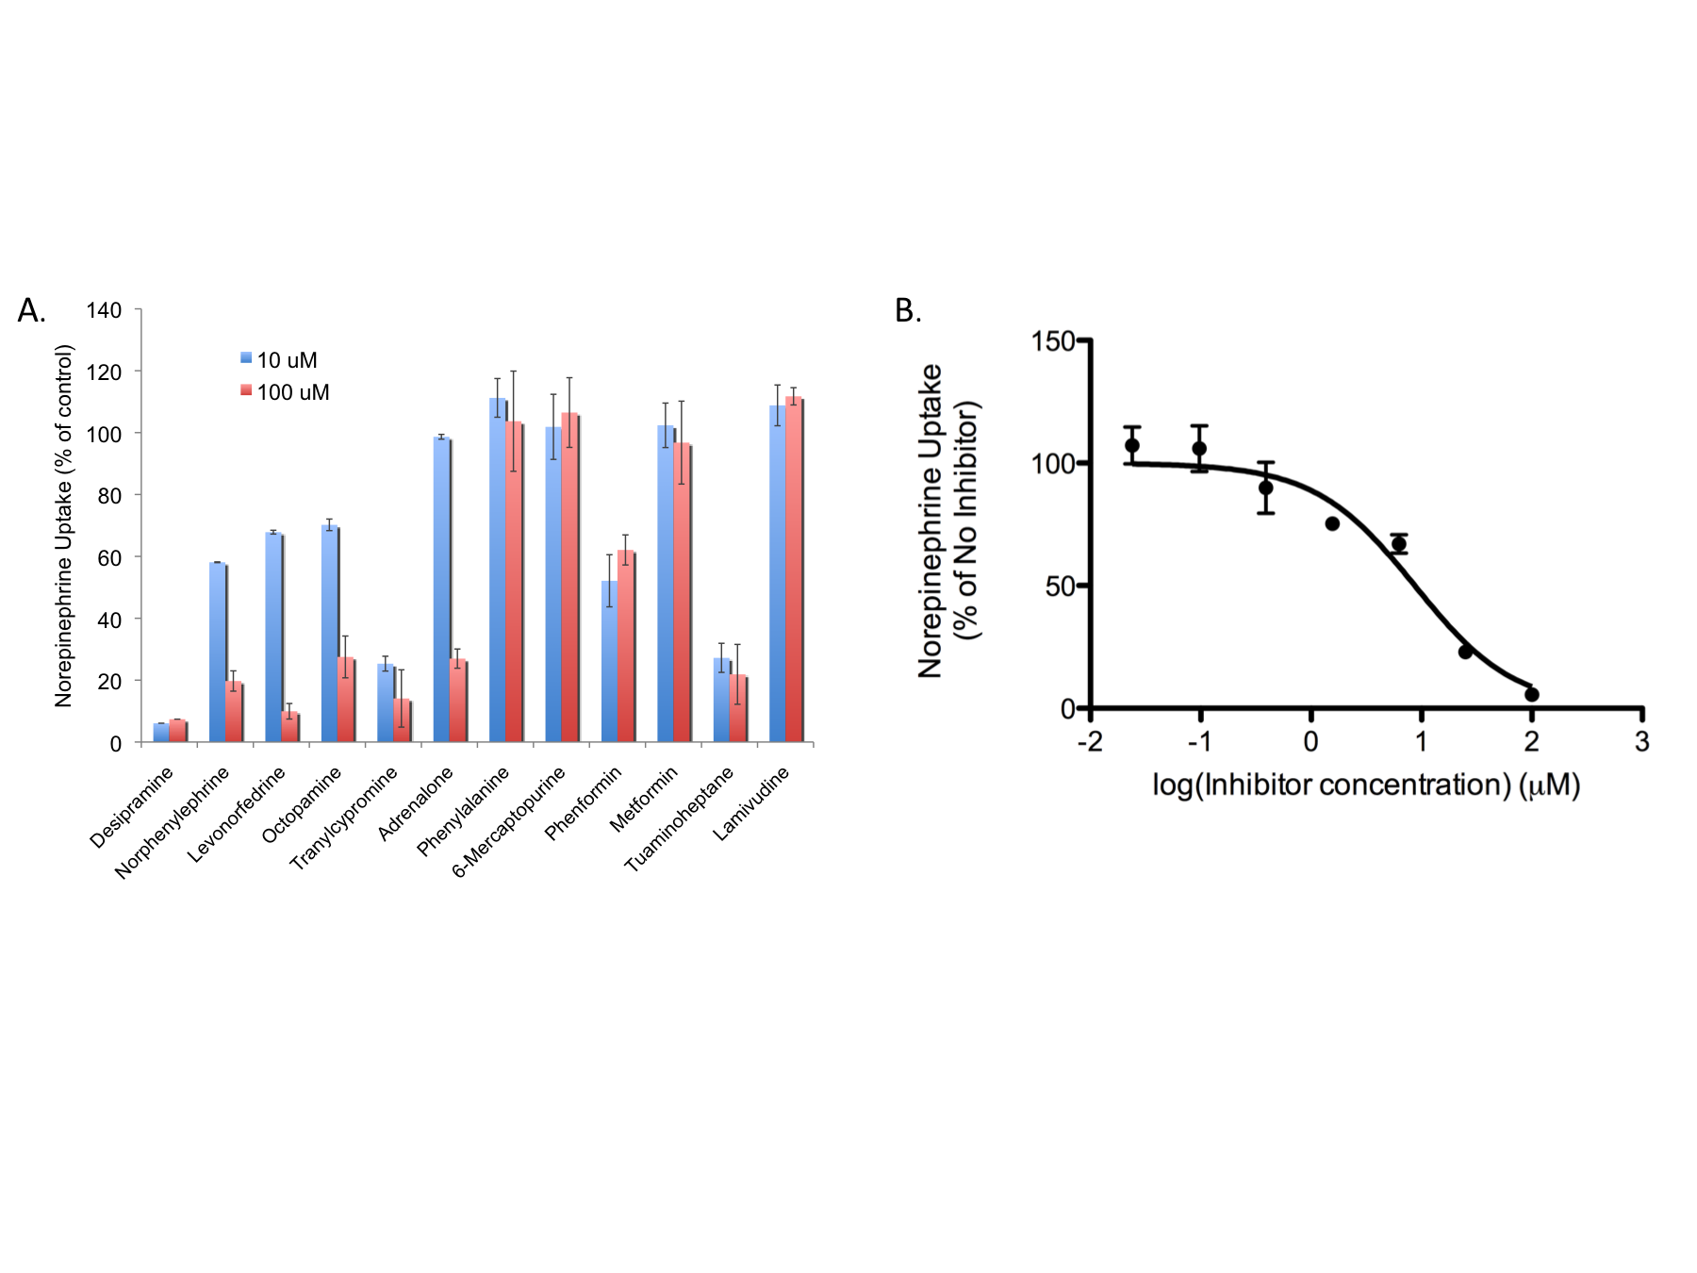
Experimentally tested drugs (Giacomini lab)
Tranylcypromine IC₅₀=8.7μM
Notes:
IC50 and molecule name

Slide 14
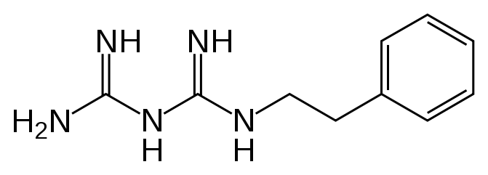
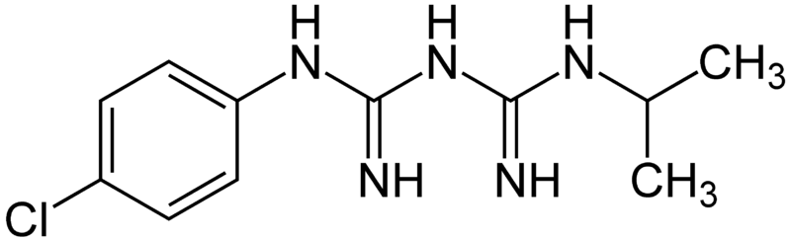
Clinical implications
Efficacy
  Sympathetic drug: Epirenor, Stryphnasal, Zondel, Corbadrin (various enzymes / receptors)
  Antidepressant: Parnate (monoamine oxidase inhibitor)
Side effects
  Anorexia and high blood pressure - Phenformin (antidiabetic)(various enzymes / receptors)
  Similar side effects for the anti-malarial drug Proguanil
Phenformin
  Proguanil
Novel scaffold
  Tuaminoheptane (no aromatic ring)
Notes:
Here I included hits that Ethan found to be inhibitors of NET in at least one experiment. However, the slide may include some compounds that didn’t work in his more recent experiments.
In the efficacy part the known function of the drug is mentioned (from public databases such as chembl and pdsp) or from the literature.
Kathy, please let me know if you prefer to slide

Slide 15



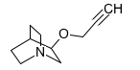
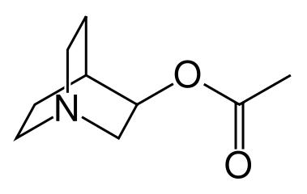
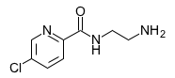
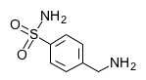

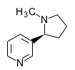
Testing additional drugs
Confirm the “linear” scaffold
Test additional novel scaffolds
Test drugs with different functions
Drug | Function | Structure
Octodrine | Vasoconstrictor; anesthetic
Milacemide | Anticonvulsant; antidepressant (MAOI)
Heptaminol | Orthostatic hypotension; vasodilator agents
Talsaclidine fumarate | Alzheimer's Disease
Aceclidine | Cholinergic; for the treatment of glaucoma
Lazabemide | Alzheimer's Disease
Mafenide | Severe burns; synthetic antimicrobial agent
Tolazolin | Vasodilator [peripheral]
Nicotine

Slide 16
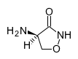
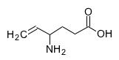
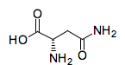
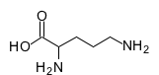
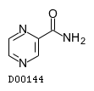
GABA transporter 2 (GAT-2; SLC6A13)
Drug | Function | Structure
Cycloserine | Antibacterial; cell wall synthesis inhibitor;
Vigabatrin | Anticonvulsant
L-Aspargine | Amino acid
Ornithine | Hepatic protectant; urea cycle
Pyrazinamide | Antibacterial [tuberculostatic]

Slide 17
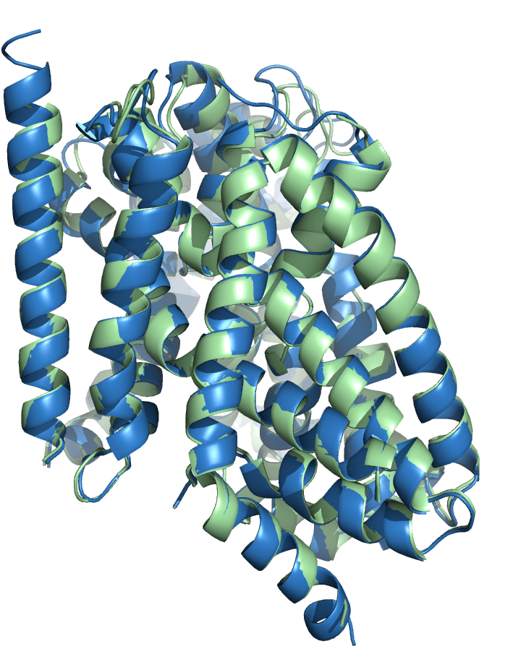
Substrate specificity of SLC6 members
GAT-2 in green
NET in blue

Slide 18
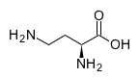
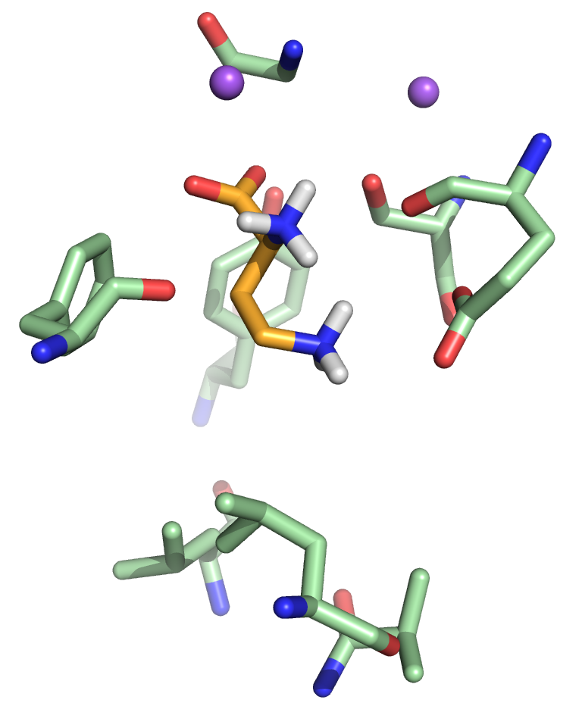
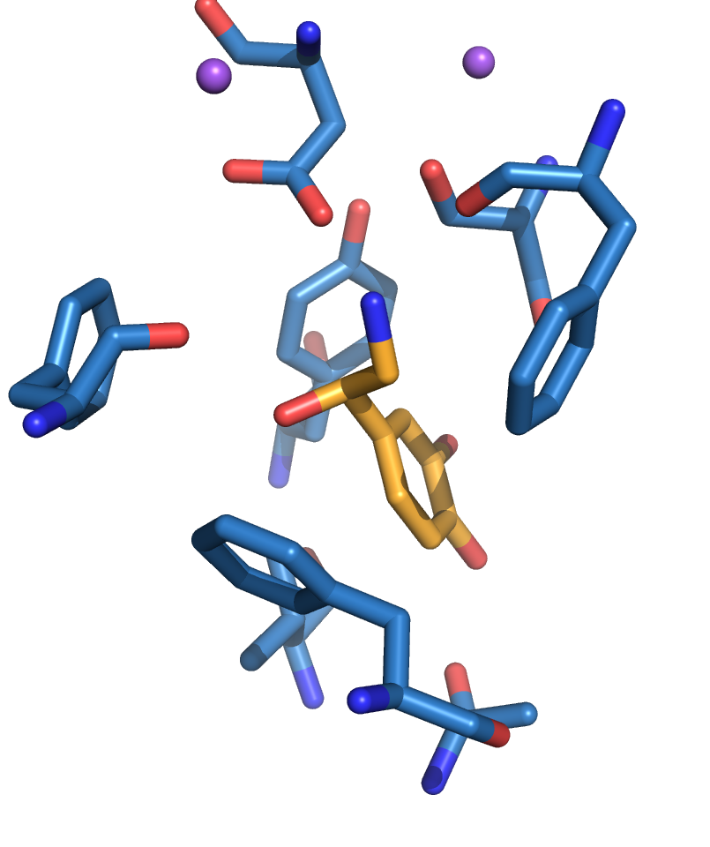
Substrate specificity of SLC6 members
GAT-2
NET
Gly33
Asp75
Glu30
Phe72
Leu276
Phe323
-NET binding site has more aromatic residues
-NET binding site is shifted
-Charged groups are located in different places

Slide 19
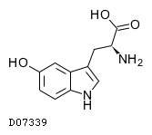
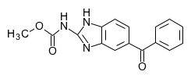
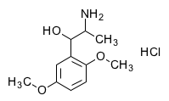
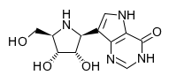
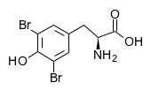
L-type amino acid transporter 1 (LAT1; SLC7A5)
Drug | Function | Structure
Oxitriptan | Antidepressant; antiepileptic
Mebendazole | Anti-worm medication
Methoxamine hydrochloride; Vasoxyl | Vasoconstrictor
Forodesine hydrochloride | Acute lymphoblastic leukemia (ALL) and cutaneous T-Cell lymphoma (CTCL)
Bromotiren | Antithyroid

Slide 20
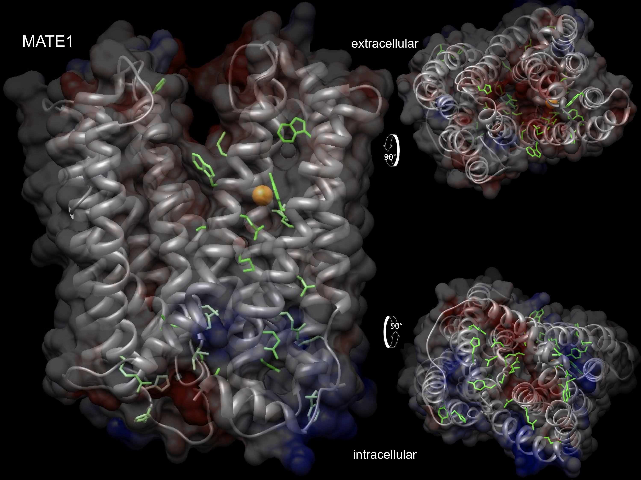
Multidrug and toxin extrusion protein 1 (MATE1; SLC47A1)
+
-

Slide 21
Summary / future work
Applied modeling / docking to a challenging target:
  a membrane protein
  <30% identity between template and target
  template and target have dissimilar binding profiles
The identified NET ligands
  explain efficacy and side effects of drugs
  exhibit novel chemistry
Predicted ligands for GAT-2 and LAT1; created models for MATE1
Rationalized difference in function between two SLC6 members
Future:
  dock ligands against various MATE1 binding sites
  apply similar approach to the open conformation SLC6 models
  test ligands (Giacomini lab)

Slide 22
Thanks!
Andrej Sali
Hao Fan
Jonathan Gable
Ursula Pieper
Bob Stroud
Andrew Waight
Kathy Giacomini
Ethan Geier
Amber Dahlin
Sook Wah Yee
Brian Shoichet
John Irwin

