Slide 1
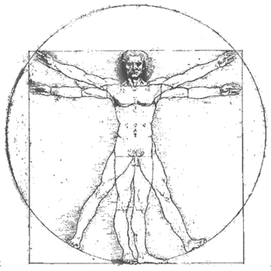
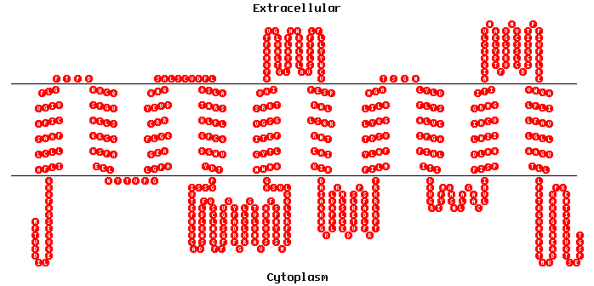
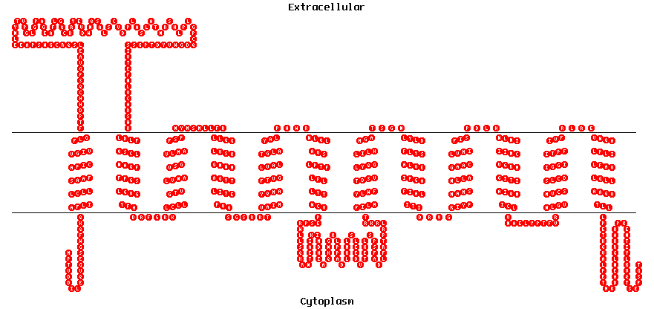
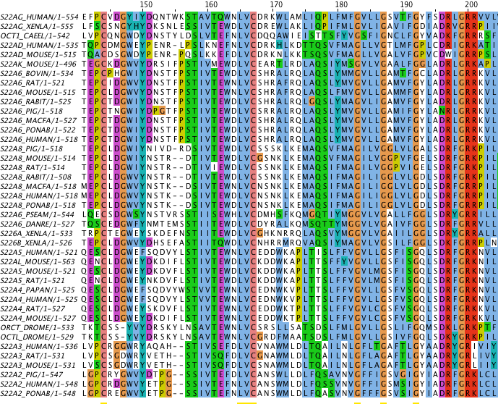
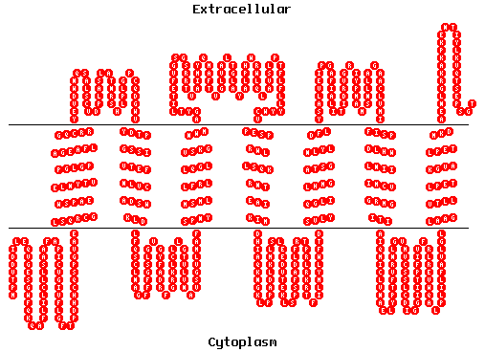
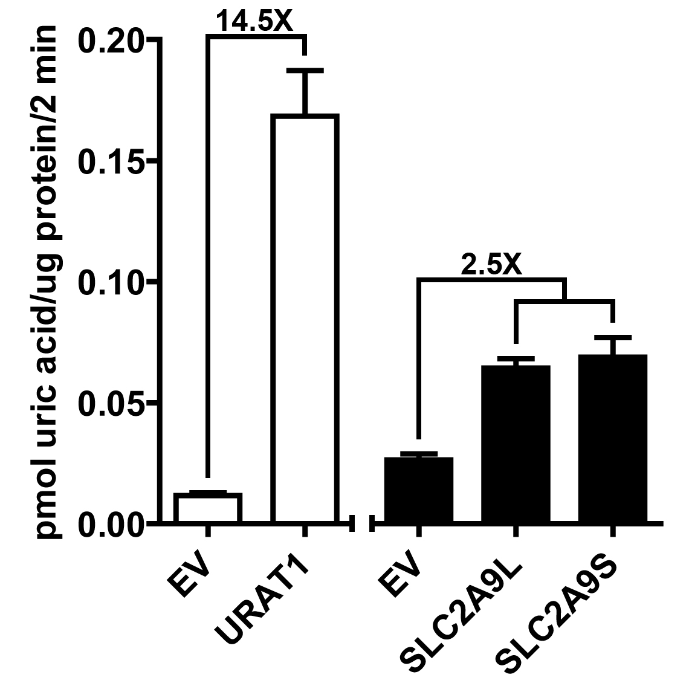
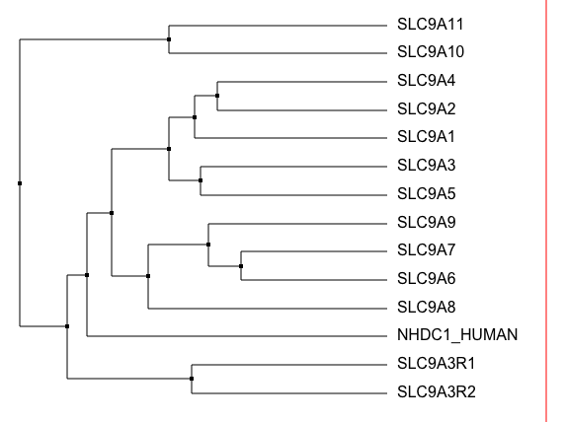
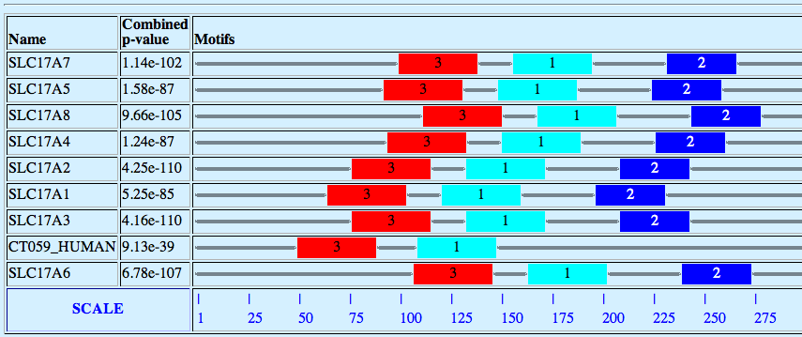
A. Collect all human ORFs
B. Predict proteins with ≥ 6 TMH
C. Create profiles for membrane proteome
E. Create profile for SLC family members
D. Extract SLC family members from databases
G. Filter predictions by additional computational analysis
F. Scan for unknown SLC family members
H. Verify by experiments

